Slide 1
Machine learning structure preserving brackets for forecasting irreversible processes
Kookjin Lee (ASU), Nat Trask, Panos Stinis (PNNL)
Center for Computing Research
Sandia National Laboratories
SAND2021-6763 PE

Slide 2
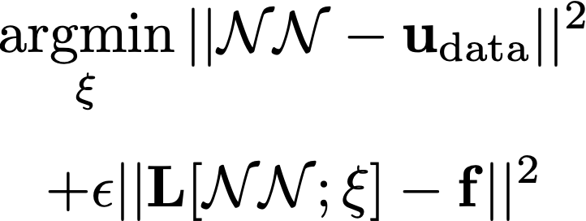
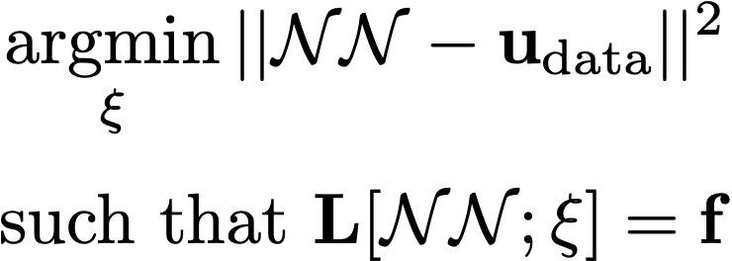
Goal: structure preserving SciML for learning ODEs
”Black-box” ML
No physics + big data
Physics-informed ML
Weak physics alleviate data requirements
Structure preserving ML
Exact physics treatment independent of data
No domain expertise Strong physical priors
Objective: Efficient machine learned surrogates that provide same accuracy, stability and physical realizability guarantees as traditional forward models in small data limits

Slide 3
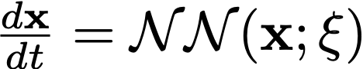
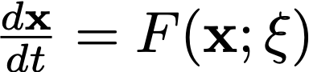
Data-driven dynamical systems for forecasting
“Black box” – no required model Strong physical priors
Universal DiffEq (UDE)
Christopher Rackauckas, Yingbo Ma, Julius Martensen, Collin Warner, Kirill Zubov, Rohit Supekar, Dominic Skinner, Ali Ramadhan, and Alan Edelman. Universal differential equations for scientific machine learning. arXiv preprint arXiv:2001.04385, 2020.
Dictionary (e.g SINDy)
Brunton, Steven L., Joshua L. Proctor, and J. Nathan Kutz. "Discovering governing equations from data by sparse identification of nonlinear dynamical systems." Proceedings of the national academy of sciences 113.15 (2016): 3932-3937.
Neural ODE (NODE)
Ricky TQ Chen, Yulia Rubanova, Jesse Bettencourt, and David Duvenaud. Neural ordinary differential equations. In Proceedings of the 32nd International Conference on Neural Information Processing Systems, pages 6572–6583, 2018.
No modeling required
Bad generalization
Difficult training
Need first principles starting point
Good forecasting
Easy to train

Slide 4
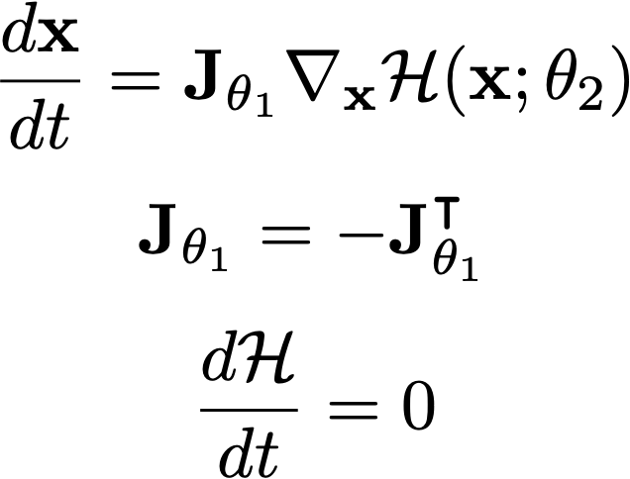
Data-driven dynamical systems for forecasting
“Black box” – no required model Structure-preserving ML Strong physical priors
Hamiltonian NN
Samuel Greydanus, Misko Dzamba, and Jason Yosinski. Hamiltonian neural networks. In H. Wallach, H. Larochelle, A. Beygelzimer, F. d'Alché-Buc, E. Fox, and R. Garnett, editors, Advances in Neural Information Processing Systems, volume 32. Curran Associates, Inc., 2019.
Symplectic RNN
Zhengdao Chen, Jianyu Zhang, Martin Arjovsky, and Léon Bottou. Symplectic recurrent neural networks. In International Conference on Learning Representations, 2019.
Universal DiffEq (UDE)
Christopher Rackauckas, Yingbo Ma, Julius Martensen, Collin Warner, Kirill Zubov, Rohit Supekar, Dominic Skinner, Ali Ramadhan, and Alan Edelman. Universal differential equations for scientific machine learning. arXiv preprint arXiv:2001.04385, 2020.
Dictionary (e.g SINDy)
Brunton, Steven L., Joshua L. Proctor, and J. Nathan Kutz. "Discovering governing equations from data by sparse identification of nonlinear dynamical systems." Proceedings of the national academy of sciences 113.15 (2016): 3932-3937.
Neural ODE (NODE)
Ricky TQ Chen, Yulia Rubanova, Jesse Bettencourt, and David Duvenaud. Neural ordinary differential equations. In Proceedings of the 32nd International Conference on Neural Information Processing Systems, pages 6572–6583, 2018.
SympNets
Pengzhan Jin, Zhen Zhang, Aiqing Zhu, Yifa Tang, and George Em Karniadakis. Sympnets: Intrinsic structure-preserving symplectic networks for identifying hamiltonian systems. Neural Networks, 132:166– 179, 2020.
Lagrangian NN
Miles Cranmer, Sam Greydanus, Stephan Hoyer, Peter Battaglia, David Spergel, and Shirley Ho. La- grangian neural networks. In ICLR 2020 Workshop on Integration of Deep Neural Models and Differential Equations, 2020.
Reversible Systems Only!
Learn a gradient flow with underlying conserved quantity
Symplectic flow implies conserved phase area = no exploding/vanishing gradients
Better forecasting, accuracy, and stability

Slide 5
Why structure-preservation for irreversible systems?
Real physics are dissipative!
How to forecast chaotic systems? Impossible to match trajectories for long time dynamics. Is it possible to learn an attractor for a dissipative chaotic system?
How to rigorously handle homogenization/coarse-graining in multiscale problems? From Mori-Zwanzig theory [1] we know coarse-graining leads to dissipation, memory, and stochasticity.
For stochastic systems, need to satisfy a fluctuation-dissipation theorem to guarantee existence and thermodynamic consistency of equilibrium statistics.
[1] Robert Zwanzig Nonequilibrium Statistical Mechanics 3rd ed., Oxford University Press, New York, 2001, S.149 ff.

Slide 6
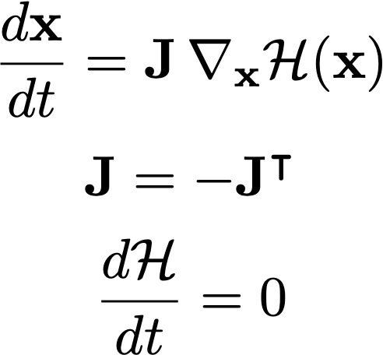
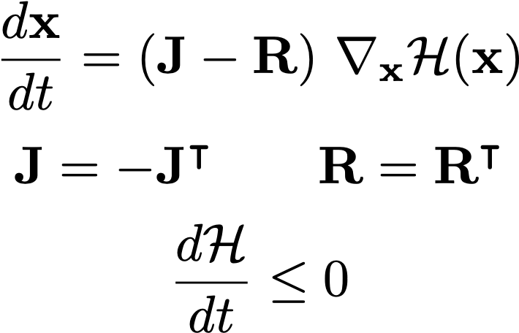
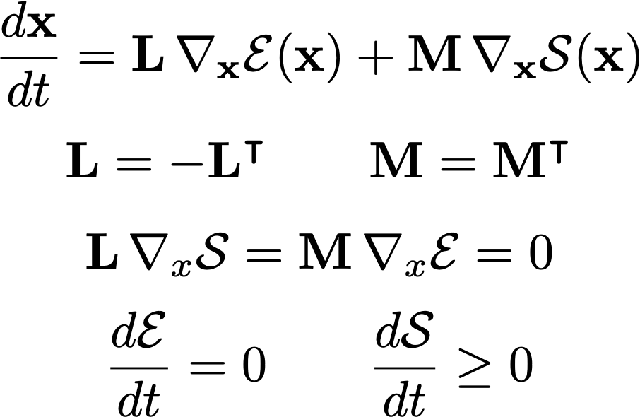
Metriplectic dynamical systems
Hamiltonian
Port-Hamiltonian
dissipation
GENERIC
Alternative formalisms for tracking generalized Casimirs to account for dissipation effects
From the physics/engineering world, many applications fit this description
Guha, Partha. "Metriplectic structure, Leibniz dynamics and dissipative systems." Journal of Mathematical Analysis and Applications 326, no. 1 (2007): 121-136

Slide 7
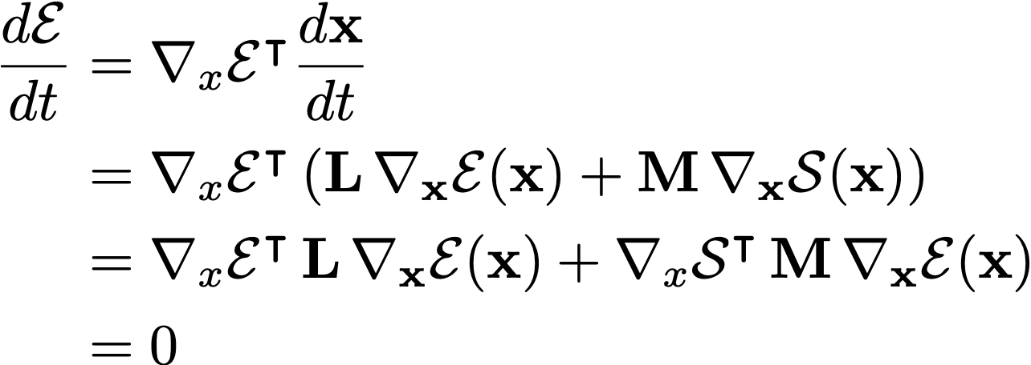
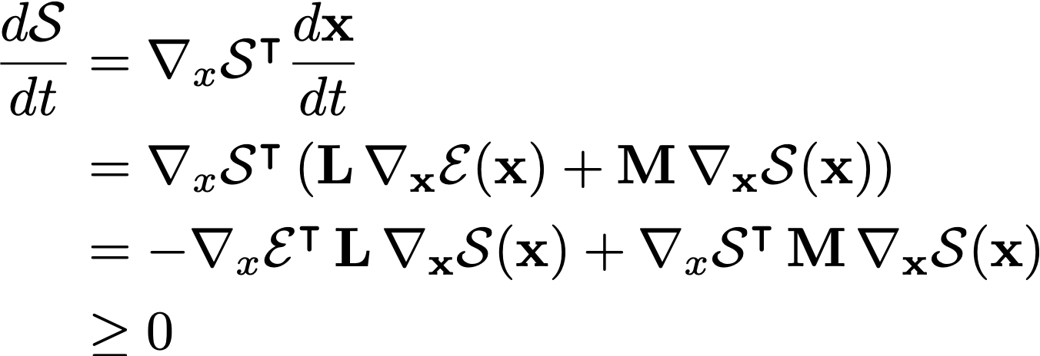
GENERIC: some more details
First law of thermodynamics
Classically, a model is derived
from first principles and one
notices GENERIC structure
We parameterize algebraic structure and discover dissipative model
Second law of thermodynamics
Challenge: how to enforce null-space condition on L and M?

Slide 8
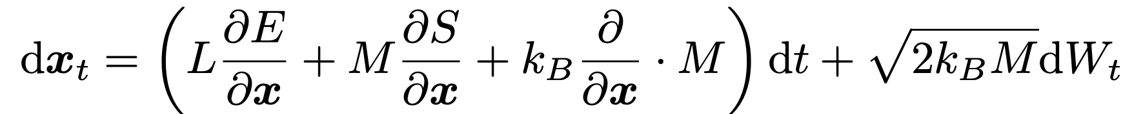
Fluctuation dissipation theorem
Reversible
Irreversible dissipation
Thermal noise
Exact treatment of reversible and irreversible dynamics allows introduction of thermal forcing which exactly balances dissipation
Implies existence of long time stationary statistics for equilibrium processes
Think of as a data-driven Mori-Zwanzig. Memory effects are encoded through the evolution of entropy and no need to treat complicated memory effects
Hans Christian Öttinger, Mark A Peletier, and Alberto Montefusco. A framework of nonequilibrium statistical mechanics. i. role and types of fluctuations. Journal of Non-Equilibrium Thermodynamics, 2020.

Slide 9
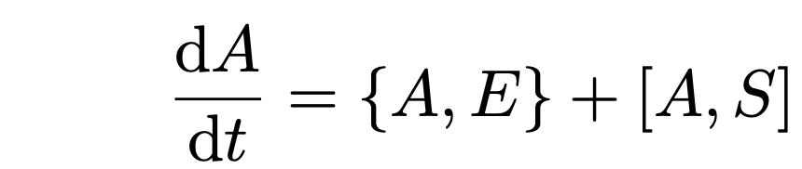
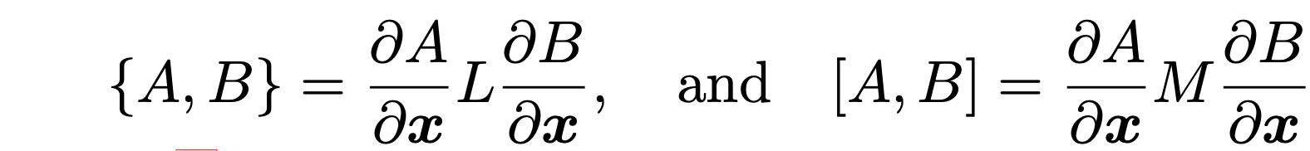
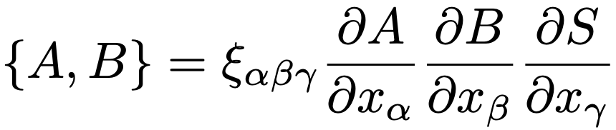
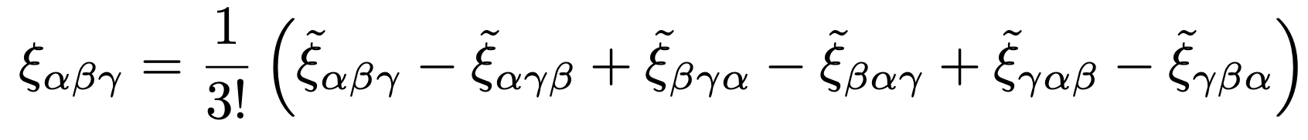
How to parameterize? Reversible piece
NN₁(x)
NN₂(x)
Reversible
Irreversible

Slide 10
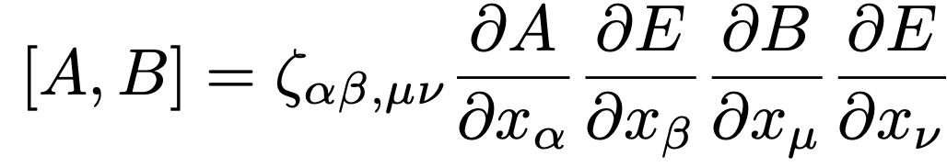
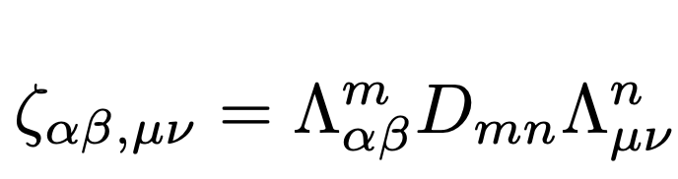
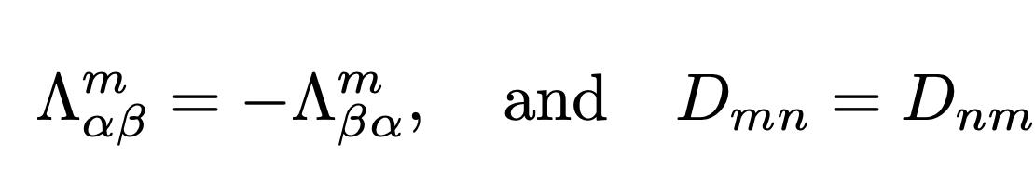
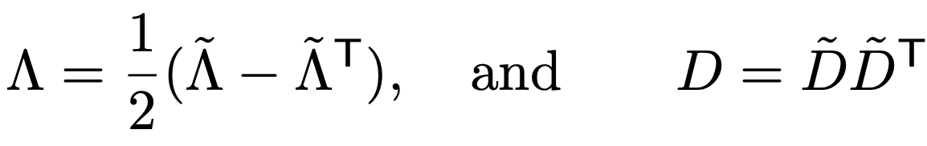
How to parameterize? Irreversible piece
NN₁(x)
NN₂(x)
Reversible
Irreversible

Slide 11
How to train
Collect data on observable states (e.g. q,p canonical coordinates)
Unobservable states (e.g. specific entropy) are not accessible, leading to hidden state in ODE (major numerical challenge)
Alternate between batch gradient descent and updating latest solution for entropy

Slide 12
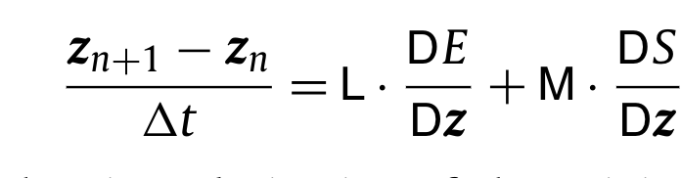
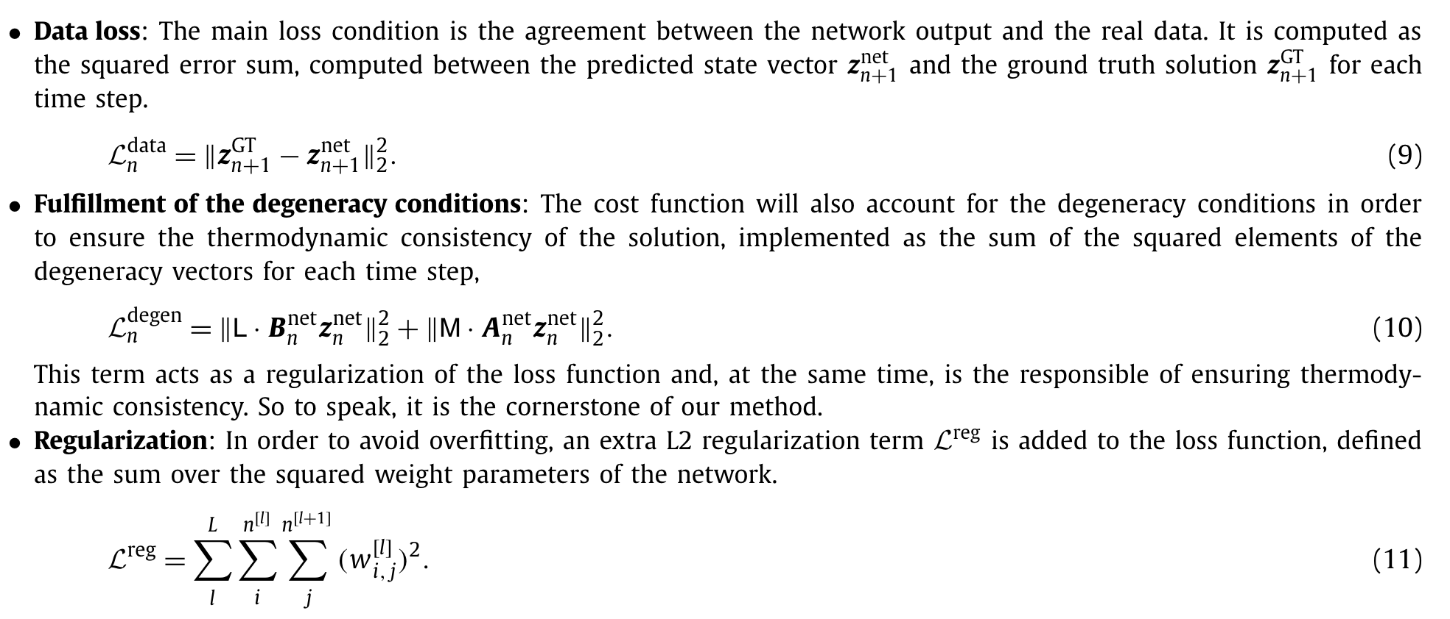
Alternate approach: PINNs-like penalties
Hernández, Quercus, et al. "Structure-preserving neural networks." Journal of Computational Physics 426 (2021): 109950.

Slide 13
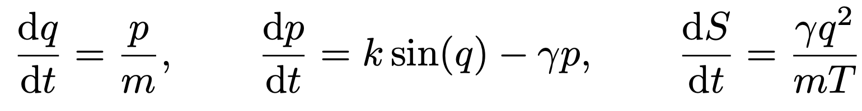
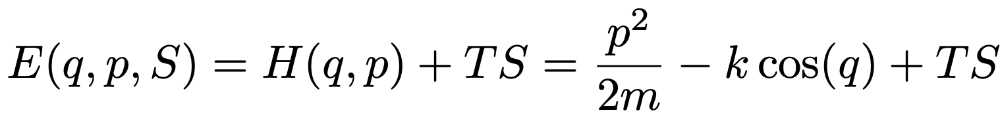
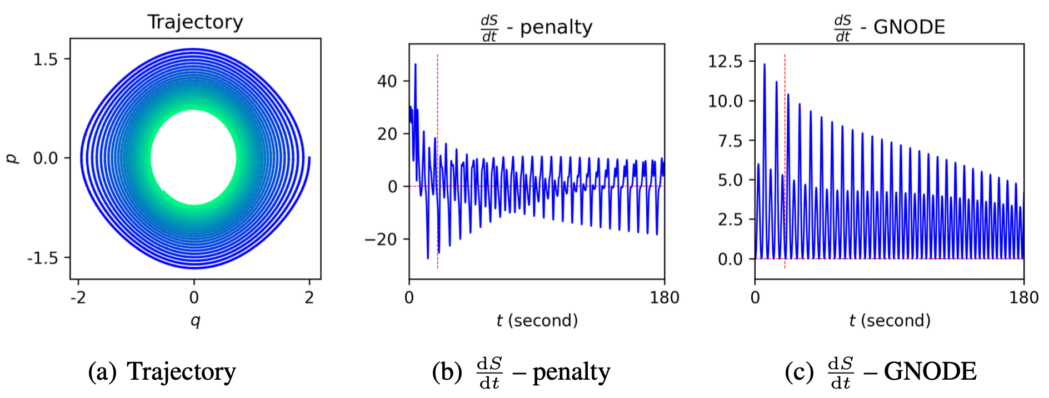
Experiments: learning dissipative pendulum

Slide 14
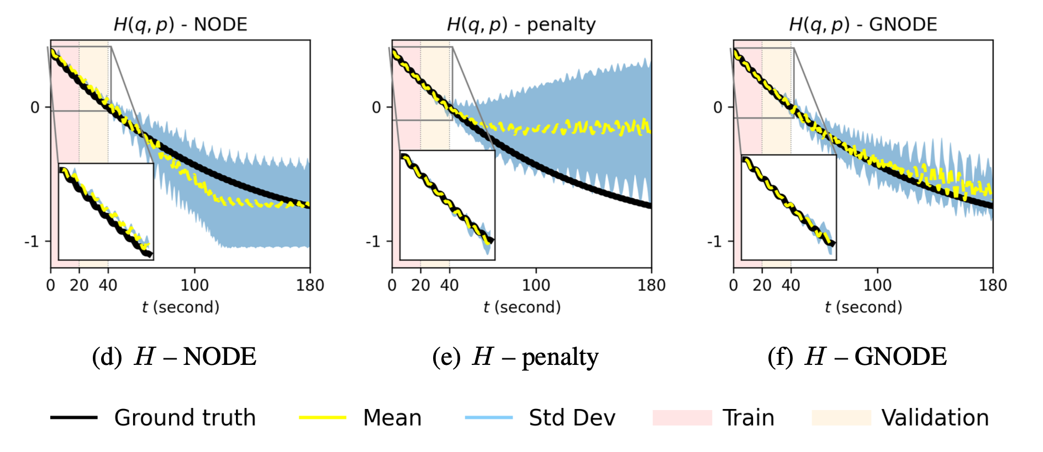
Experiments: learning dissipative pendulum
For this problem we have an exact formula for the entropy S = E - (1/T) H(q,p)
Unlike black box or penalty approach, we learn a nearby approximation to entropy which tracks the true entropy well

Slide 15
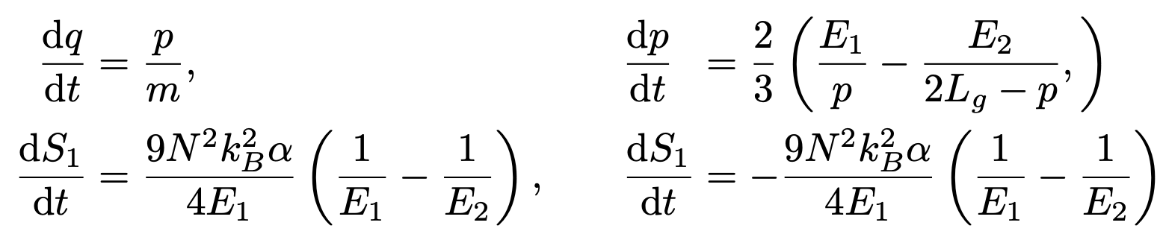
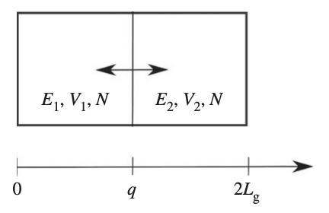
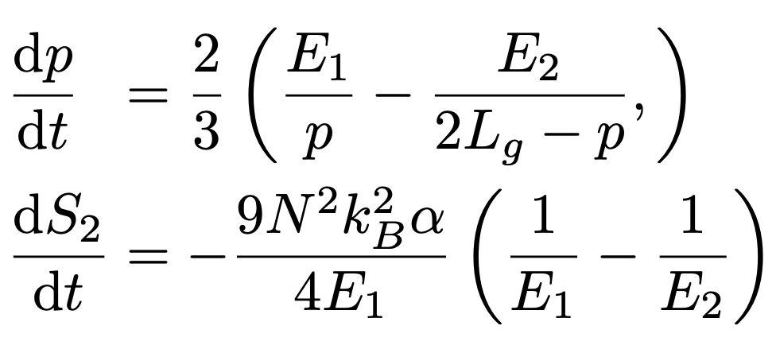
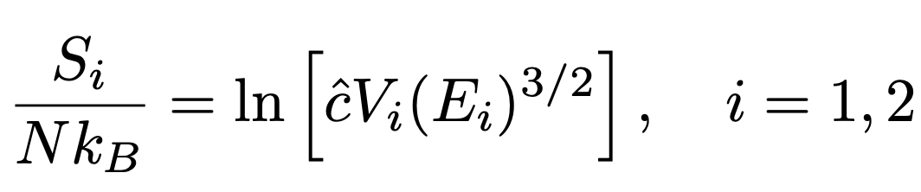
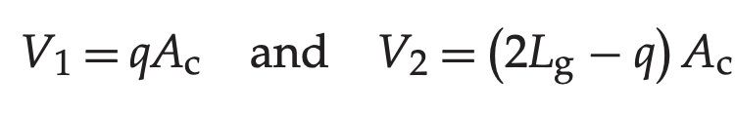
Experiments: piston driven by two gases
Shang, Xiaocheng, and Hans Christian Öttinger. "Structure-preserving integrators for dissipative systems based on reversible–irreversible splitting." Proceedings of the Royal Society A 476.2234 (2020): 20190446.

Slide 16
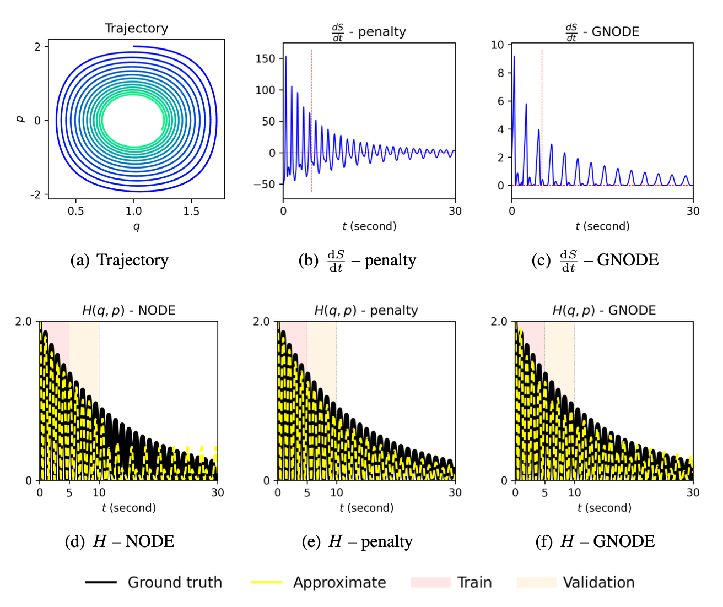
Experiments: piston driven by two gases

Slide 17
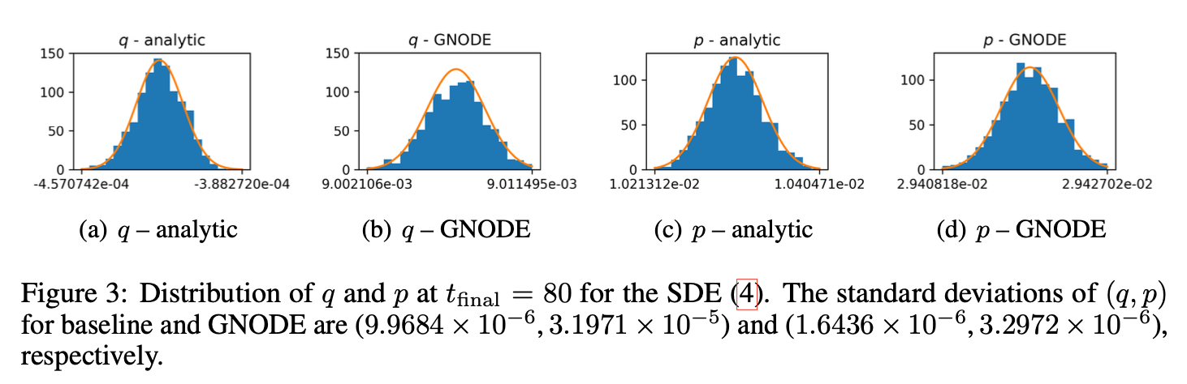
Fluctuation dissipation theorem: stochastic pendulum
Idea: Extract dynamics from data and then use FDT to introduce thermodynamically consistent noise

Slide 18

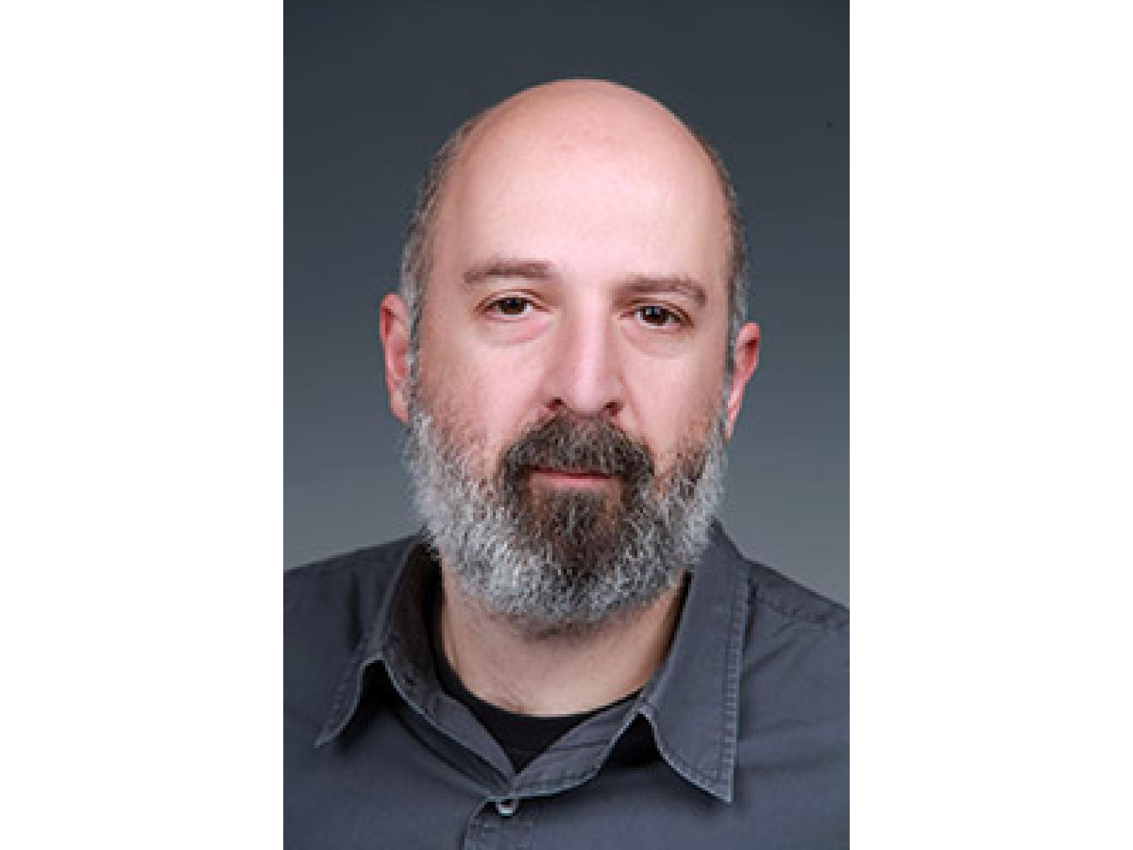
Conclusions and acknowledgements
Presented a general framework which exactly preserves structure and may be used to support a range of data-driven modeling, robotics, control applications
Many problem specific simplifications are possible!
Some follow-on work:
Lee, K., Trask, N. and Stinis, P., 2021. Structure-preserving Sparse Identification of Nonlinear Dynamics for Data-driven Modeling. arXiv preprint arXiv:2109.05364.
Funding sources:
DOE early career award
Philms (DOE ASCR MMICCs center)
Please reach out if interested!
(natrask@sandia.gov)

